Slide 1
DEPED Public Schools Enrollment Dataset
Aquino, Kurt
Choy, Seaver
Matias, Angelo

Slide 2
DepEd Public Schools Enrollment Dataset
Name: Philippine's Public Schools Enrollment Dataset for S.Y. 2015-2016
Size: Total of 62.7MB for 5 Excel files (SY 2011-2012 to SY 2015-2016)
Source: http://www.deped.gov.ph/datasets
Contains the number of male and female enrollees in each level for all public schools in the country from S.Y. 2011 - 2012 up to S.Y. 2015 - 2016 as of September 30, 2015 from before and after the implementation of the K to 12 Program

Slide 3
DepEd Public Schools Enrollment Dataset
Also contains general details for identifying each respective school
School ID - Unique 6-digit reference number issued to schools in the basic education system
School Name - Official name as registered in DepEd
Region
Province
Municipality
Division - DepEd division (province or city) supervising the school
District - DepEd district supervising the school

Slide 4
Data Preprocessing
The group created their own ETL using both Java and MySQL
Separated Excel sheets per School Year
Convert to CSV files
Extract only necessary data
Data cleaning did not present significant difficulties
Data sets were already structured
Minor inconsistencies
The group focused on designing a new model so that the data could easily be accessed in order to apply OLAP queries and analytics

Slide 5
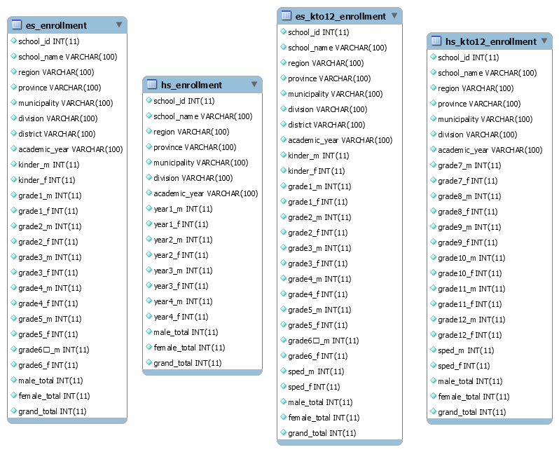

Slide 6
Feature Selection
Prediction of the number of Grade 1 elementary student and 1st year high school student enrollees
Gives a prediction whether the number of enrollees would increase or decrease based on the trends of enrollment in the past years
Enrollment Trends per grade level per year
Shows the enrollment trends by presenting them in a line graph
Percentage of students in the Special Education Program
Provides an idea on which public schools have a very large or very small number of special students

Slide 7
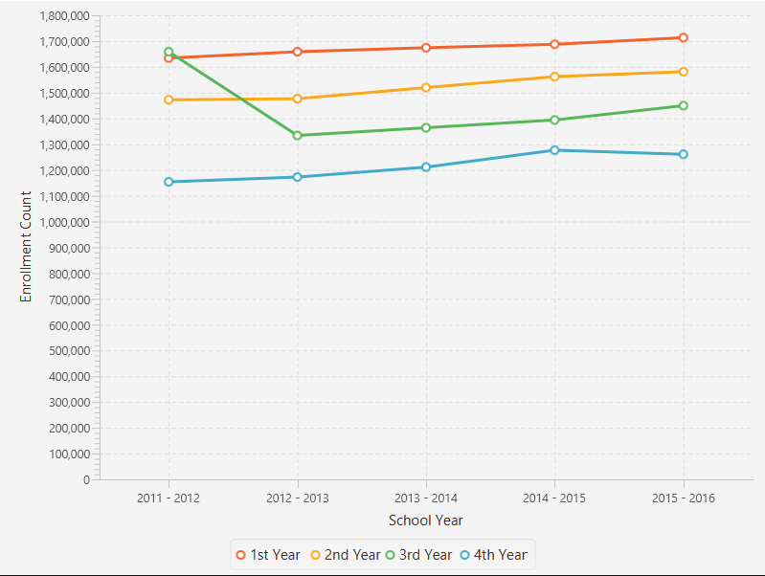
Visualization
Prediction of the number of Grade 1 elementary student and 1st year high school student enrollees and the enrollment trend

Slide 8
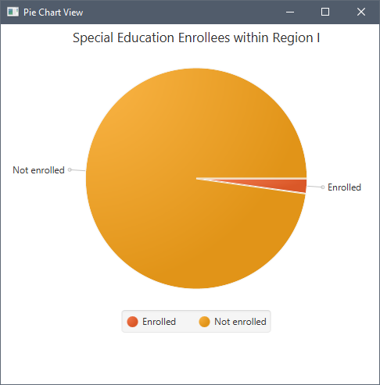
Visualization
Percentage of students in the Special Education Program

Slide 9
Analytics
Prediction of the number of Grade 1 elementary student and 1st year high school student enrollees
The group used a neural network model to predict whether the number of enrollees would go up or down based on the trend for the succeeding year.
Enrollment trends per grade level per year
No specific models were used as the feature is only supposed to display the data. The enrollment details for the entire duration of the gathering (SY 2011-2012 to SY 2015-2016) were combined per school in order to visualize the trends
Percentage of students in the Special Education program per public school
The group simply get the total number of students enrolled in the special education program and compared it with those who are not

Slide 10
Interpretation, Findings and Conclusion
Overall, the group was able to conclude that the trends for the enrollment counts increase per grade level as the academic years proceed.
Through the data sets provided by the Department of Education, the group was able to create an application which makes use of the available data by presenting them in varying visualizations as well as by applying various analyzations in the process.
Considering the increasing amount of data which would be available in the succeeding years, further accurate predictions and more specific visualizations.

